Slide 1
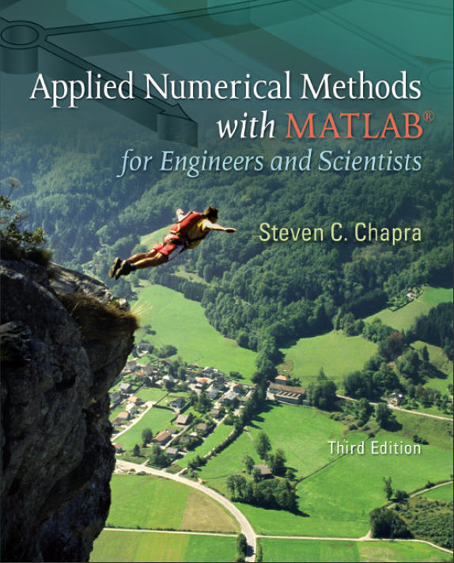
Part 2
Chapter 7
Optimization
PowerPoints organized by Dr. Michael R. Gustafson II, Duke University
All images copyright © The McGraw-Hill Companies, Inc. Permission required for reproduction or display.

Slide 2
Chapter Objectives
Understanding why and where optimization occurs in engineering and scientific problem solving.
Recognizing the difference between one-dimensional and multi-dimensional optimization.
Distinguishing between global and local optima.
Knowing how to recast a maximization problem so that it can be solved with a minimizing algorithm.
Being able to define the golden ratio and understand why it makes one-dimensional optimization efficient.

Slide 3
Objectives (cont)
Locating the optimum of a single-variable function with the golden-section search.
Locating the optimum of a single-variable function with parabolic interpolation.
Knowing how to apply the fminbnd function to determine the minimum of a one-dimensional function.
Being able to develop MATLAB contours and surface plots to visualize two-dimensional functions.
Knowing how to apply the fminsearch function to determine the minimum of a multidimensional function.

Slide 4
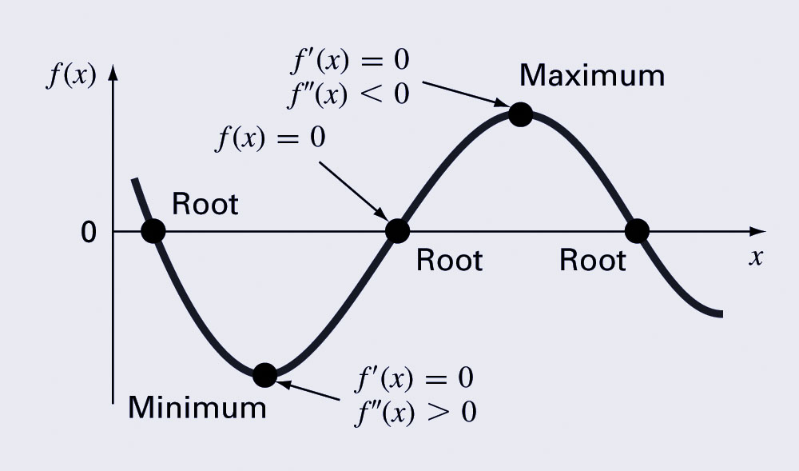
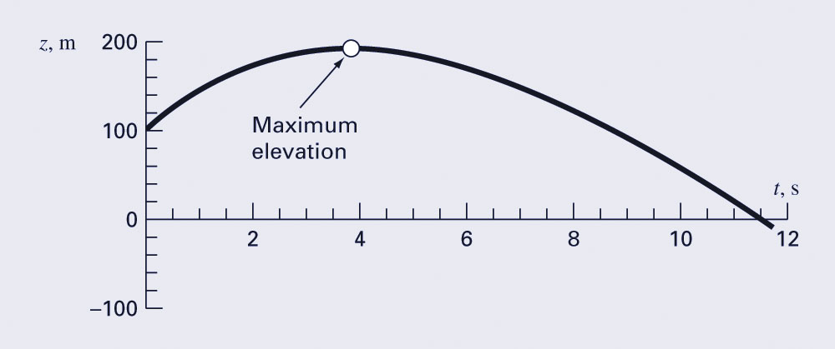
Optimization
Optimization is the process of creating something that is as effective as possible.
From a mathematical perspective, optimization deals with finding the maxima and minima of a function that depends on one or more variables.

Slide 5
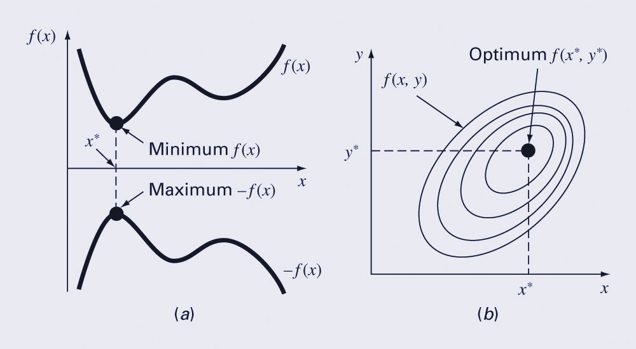
Multidimensional Optimization
One-dimensional problems involve functions that depend on a single dependent variable -for example, f(x).
Multidimensional problems involve functions that depend on two or more dependent variables - for example, f(x,y)

Slide 6
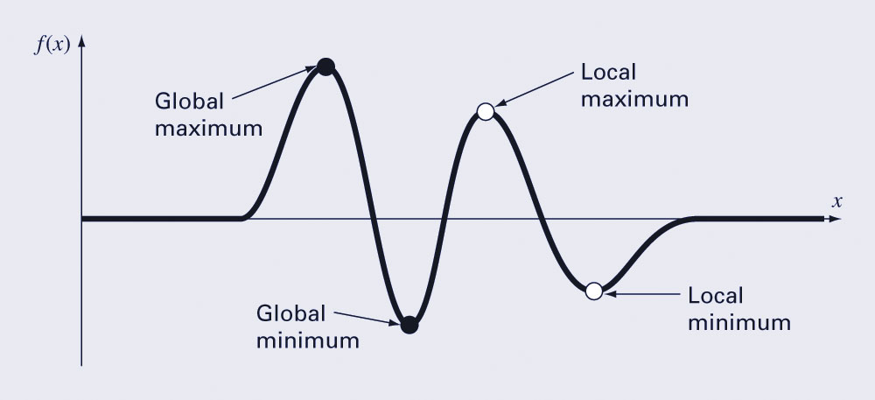
Global vs. Local
A global optimum represents the very best solution while a local optimum is better than its immediate neighbors. Cases that include local optima are called multimodal.
Generally desire to find the global optimum.

Slide 7
Golden-Section Search
Search algorithm for finding a minimum on an interval [x_{l} x_{u}] with a single minimum (unimodal interval)
Uses the golden ratio φ=1.6180… to determine location of two interior points x₁ and x₂; by using the golden ratio, one of the interior points can be re-used in the next iteration.

Slide 8
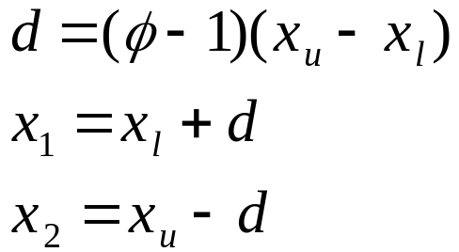
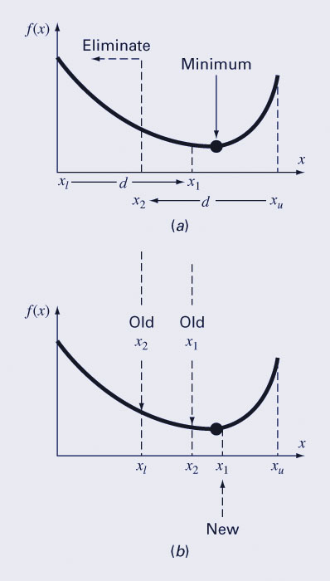
Golden-Section Search (cont)
If f(x₁)<f(x₂), x₂ becomes the new lower limit and x₁ becomes the new x₂ (as in figure).
If f(x₂)<f(x₁), x₁ becomes the new upper limit and x₂ becomes the new x₁.
In either case, only one new interior point is needed and the function is only evaluated one more time.

Slide 9
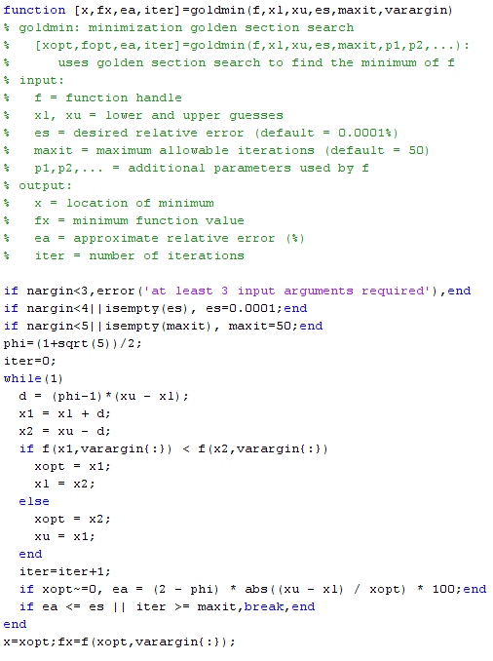
Code for Golden-Section Search

Slide 10
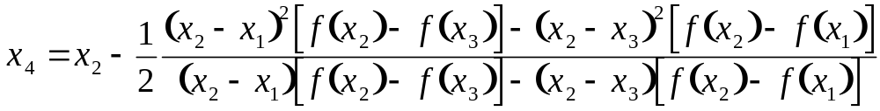
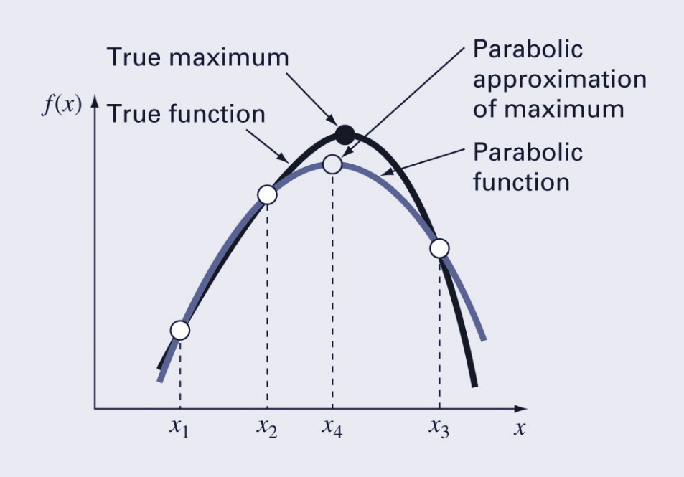
Parabolic Interpolation
Another algorithm uses parabolic interpolation of three points to estimate optimum location.
The location of the maximum/minimum of a parabola defined as the interpolation of three points (x₁, x₂, and x₃) is:
The new point x₄ and the two
surrounding it (either x₁ and x₂
or x₂ and x₃) are used for the
next iteration of the algorithm.

Slide 11
fminbnd Function
MATLAB has a built-in function, fminbnd, which combines the golden-section search and the parabolic interpolation.
  [xmin, fval] = fminbnd(function, x1, x2)
Options may be passed through a fourth argument using optimset, similar to fzero.

Slide 12
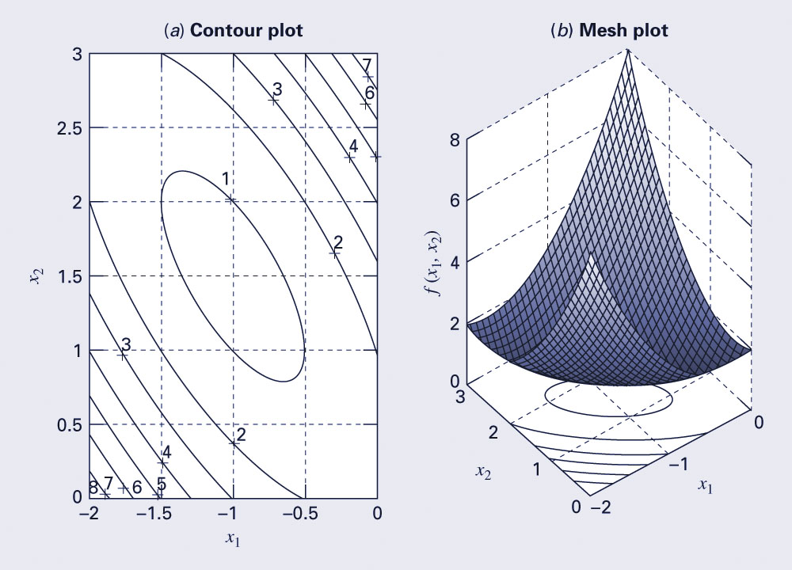
Multidimensional Visualization
Functions of two-dimensions may be visualized using contour or surface/mesh plots.

Slide 13
fminsearch Function
MATLAB has a built-in function, fminsearch, that can be used to determine the minimum of a multidimensional function.
  [xmin, fval] = fminsearch(function, x0)
  xmin in this case will be a row vector containing the location of the minimum, while x0 is an initial guess. Note that x0 must contain as many entries as the function expects of it.
The function must be written in terms of a single variable, where different dimensions are represented by different indices of that variable.

Slide 14
fminsearch Function
To minimize
f(x,y)=2+x-y+2x²+2xy+y²
rewrite as
f(x₁, x₂)=2+x₁-x₂+2(x₁)²+2x₁x₂+(x₂)²
f=@(x) 2+x(1)-x(2)+2*x(1)^2+2*x(1)*x(2)+x(2)^2
[x, fval] = fminsearch(f, [-0.5, 0.5])
Note that x0 has two entries - f is expecting it to contain two values.
MATLAB reports the minimum value is 0.7500 at a location of [-1.000 1.5000]

